Slide 1


Objectives
In this session, you will learn to:
Basic properties of CSS
Understanding Box Model
How to Layout Webpage use CSS
Understanding Flex box Layout (CSS3)
Designing layout of website

Slide 2
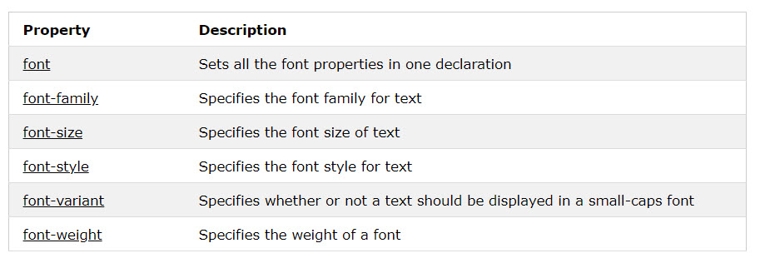
CSS Fonts
Define the font family, boldness, size, and the style of a text.
Some CSS font properties:

Slide 3
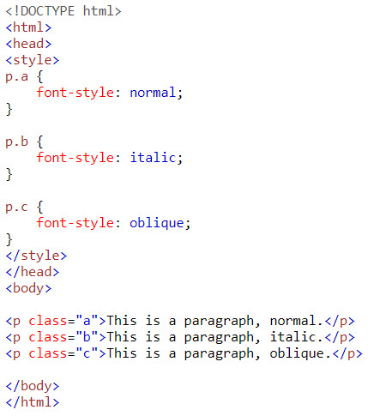
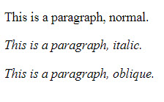
CSS Fonts
Example:
Result:

Slide 4
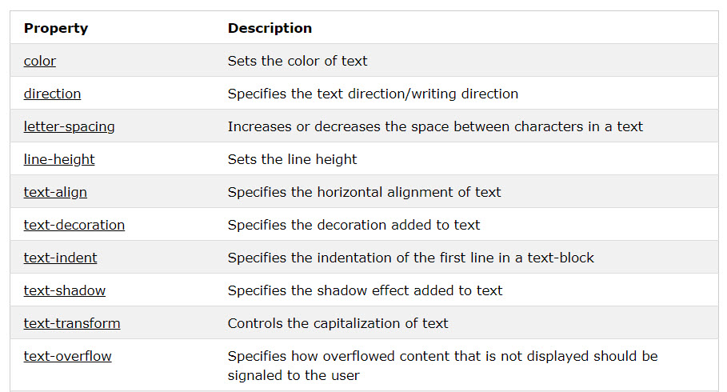
CSS Text
Some CSS Text Properties:

Slide 5
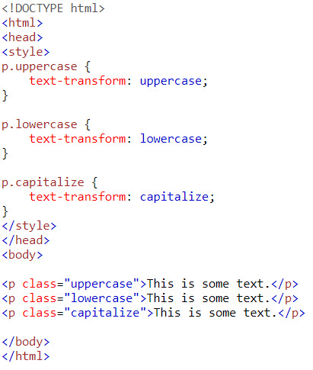
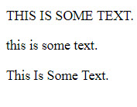
CSS Text
Example:
Result:

Slide 6
CSS Background
Some CSS Text Properties:
Property | Description
background | Sets all the background properties in one declaration
background-color | Sets the background color of an element
background-image | Sets the background image for an element
background-origin | Specifies where the background image(s) is/are positioned
background-position | Sets the starting position of a background image
background-repeat | Sets how a background image will be repeated
background-size | Specifies the size of the background image(s)

Slide 7
CSS background
Example:
Result:

Slide 8
Box Model
All HTML elements can be considered as boxes. In CSS, the term "box model" is used when talking about design and layout.
The CSS box model is essentially a box that wraps around every HTML element. It consists of: margins, borders, padding, and the actual content

Slide 9
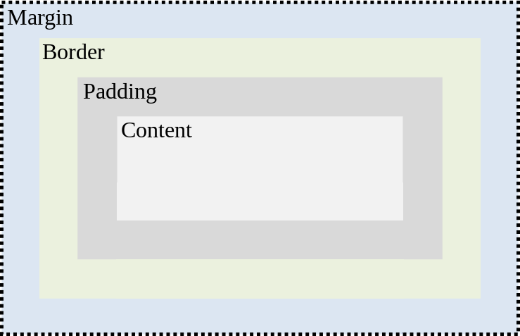
Box Model

Slide 10
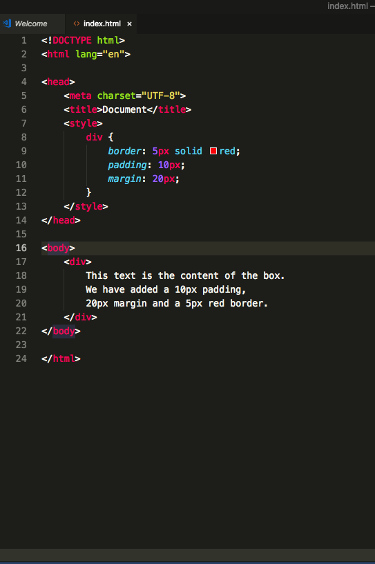
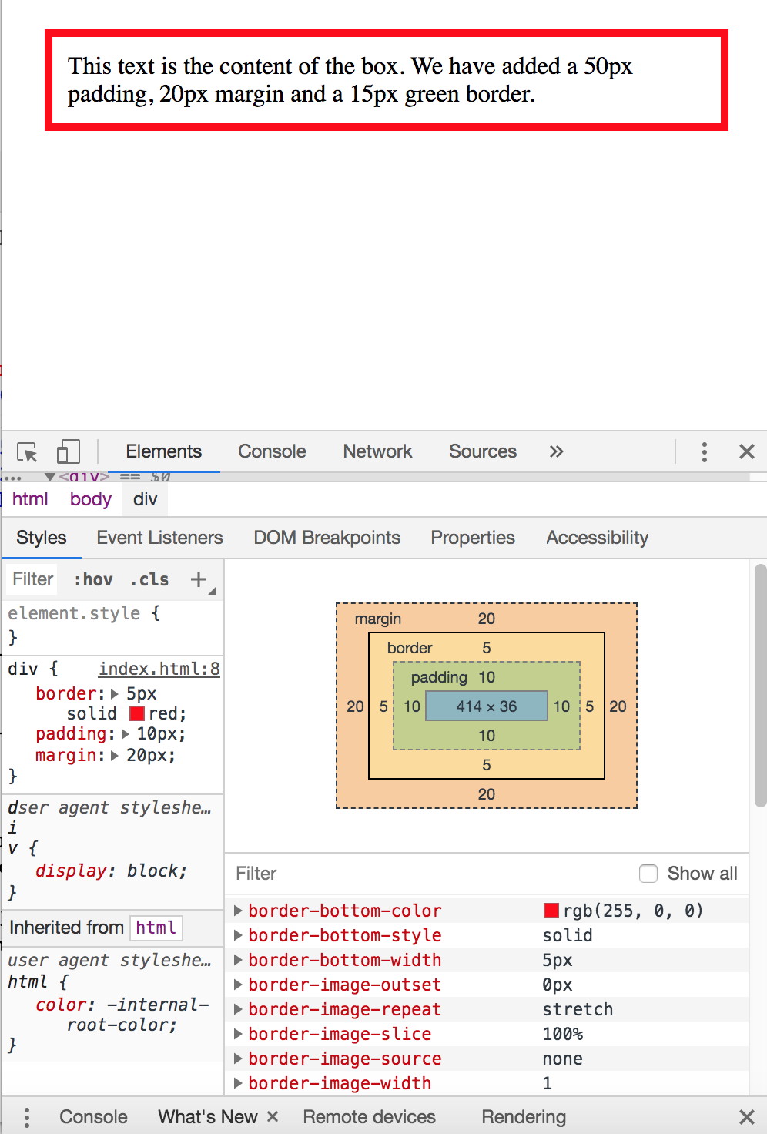
Box Model
Example
Result

Slide 11
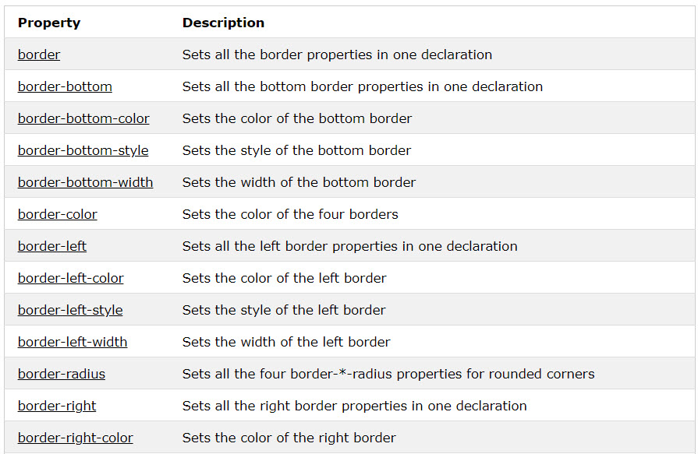
CSS Border
Allow you to specify the style, width, and color of an element's border.
Some border’s properties:

Slide 12
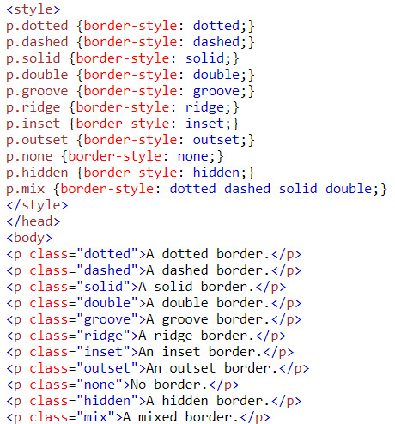
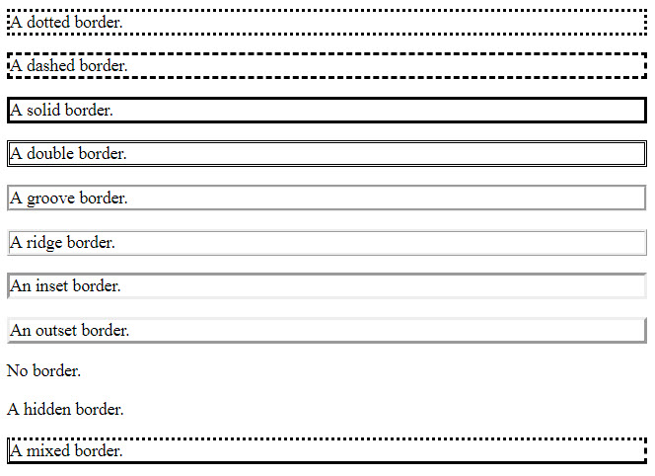
CSS Border
Example:
Result:

Slide 13
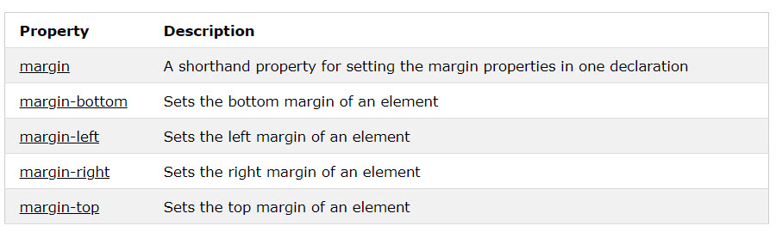
CSS Margins
Are used to create space around elements, outside of any defined borders.
With CSS, you have full control over the margins. There are properties for setting the margin for each side of an element (top, right, bottom, and left).

Slide 14
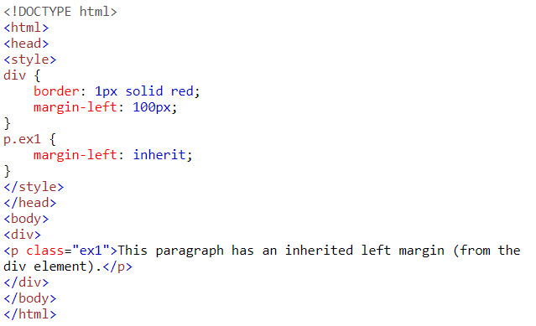

CSS Margin
Example:
Result:

Slide 15
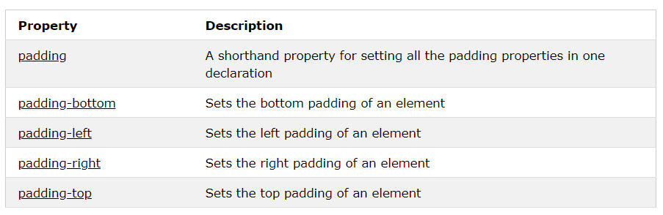
CSS Padding
Are used to generate space around an element's content, inside of any defined borders.
With CSS, you have full control over the padding. There are properties for setting the padding for each side of an element (top, right, bottom, and left).

Slide 16
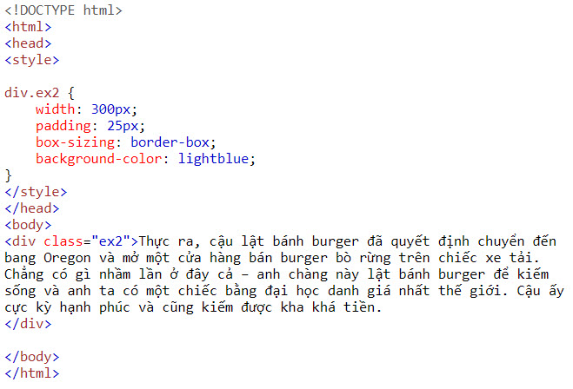
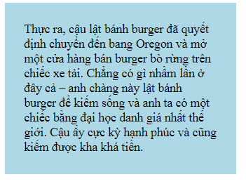
CSS Padding
Example:
Result:

Slide 17
How to layout webpage
To layout an webpage, you must remember two things:
How to positioning HTML elements (position,float,clear properties)
The display type of elements ( display properties)

Slide 18
Positioning HTML Elements
CSS positioning properties:
Are used to control the placement of elements on a Web page.
The position property is used to position an element on a Web page using the following positioning methods:
Static
Fixed
Relative
Absolute
Position property come with another bunch properties is margin, left, top, right, bottom properties
Notes:
Static positioned elements are not affected by the top, bottom, left, and right properties.
An element with position: relative; is positioned relative to its normal position.
An element with position: fixed; is positioned relative to the viewport, which means it always stays in the same place even if the page is scrolled. The top, right, bottom, and left properties are used to position the element.
An element with position: absolute; is positioned relative to the nearest positioned ancestor (instead of positioned relative to the viewport, like fixed).

Slide 19
Static Position
HTML elements are positioned static by default
An element with position: static; is not positioned in any special way; it is always positioned according to the normal flow of the page
Static Position do not support left, right, bottom, top properties

Slide 20
Relative Position
An element with position: relative; is positioned relative to its normal position.
Setting the top, right, bottom, and left properties of a relatively-positioned element will cause it to be adjusted away from its normal position. Other content will not be adjusted to fit into any gap left by the element.

Slide 21
Fixed Position
An element with position: fixed; is positioned relative to the viewport, which means it always stays in the same place even if the page is scrolled. The top, right, bottom, and left properties are used to position the element.

Slide 22
Absolute Position
An element with position: absolute; is positioned relative to the nearest positioned ancestor (instead of positioned relative to the viewport, like fixed).

Slide 23

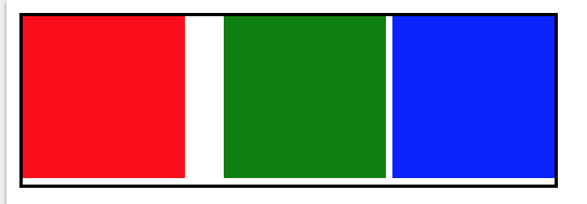
Static Position
Example
#two {
background: green;
margin-left:20px
}

Slide 24
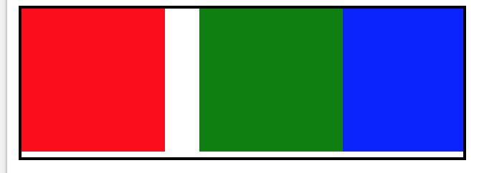
Relative Position
Example
#two {
position:relative;
background:green;
left:20px
}

Slide 25
Note
In Absolute position, if the parent element don’t have relative properties, the child element which has absolute properties will get viewport as parent

Slide 26

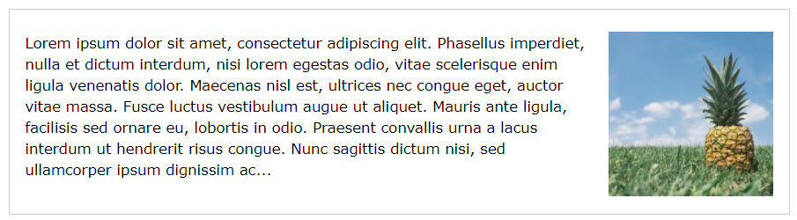
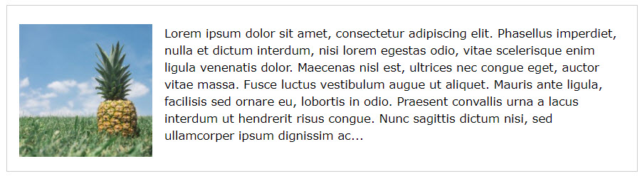

Positioning HTML Elements (Contd.)

Slide 27
Positioning HTML Elements (Contd.)
The clear property:
Is used to turn off the float effect on HTML elements.
Can be specified by using the following syntax:
clear: both|left|right;
The following embedded Notepad file contains the code to show the use of clear
property:

Slide 28
Display properties
This properties control what the way of elements display
The popular properties is: inline, block, inline-block

Slide 29
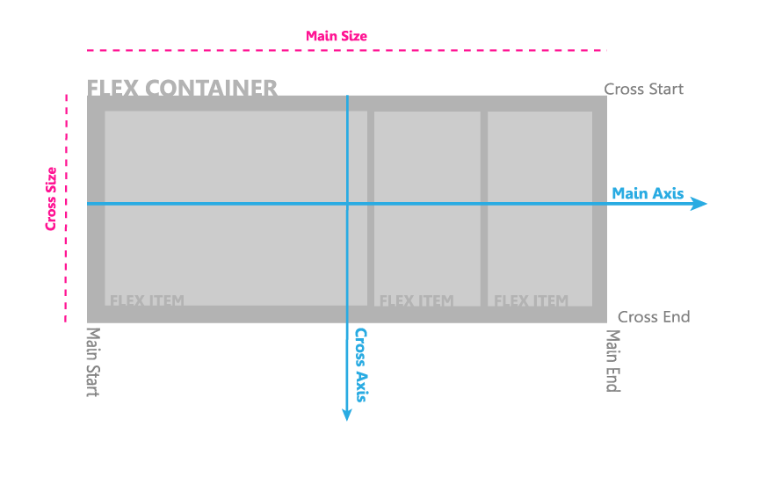
Flexbox

Slide 30
FlexBox
display:flex
flex-direction:row | row-reverse | column | column-reverse;

Slide 31
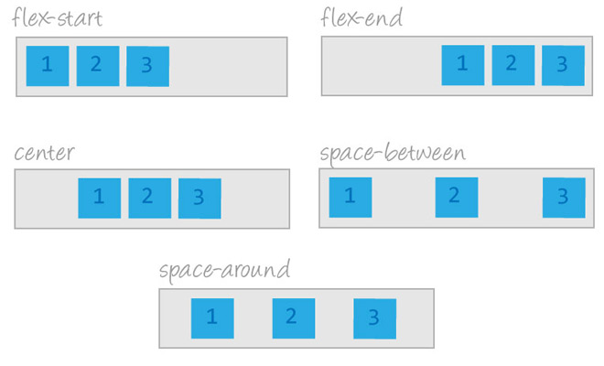
FlexBox
Justify-content
This defines the alignment along the main axis

Slide 32
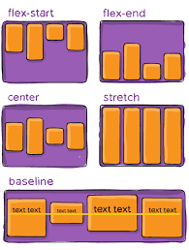
FlexBox
Align-items

Slide 33
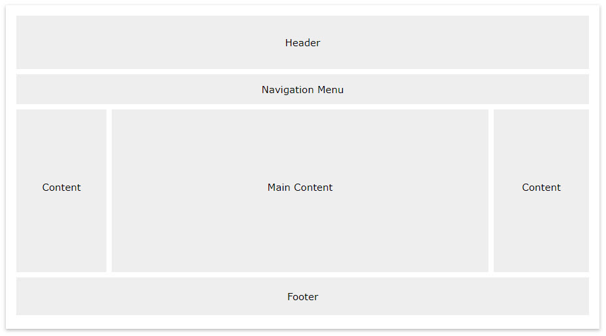
Layout
A typical layout of a website

Slide 34
Layout
Demo designing layout web page by using CSS

Slide 35
Summary
Advanced properties of CSS
Properties of CSS3
Designing layout of website

